Slide 1
Software Documentation
Dr. Nouh Alhindawi
The Forms of Software
Documentation
Chapter2: Writing to Teach- Tutorials
Chapter3: Writing to Guide- Procedures
Chapter4: Writing to Support- References

Slide 2
Chapter 2
Writing to Teach - Tutorials

Slide 3
People tend to associate the teaching level of support
(tutorial) with novice users, but tutorials often serve as quick, first introduction to new software for experienced or advanced users.
Tutorials follow principles of instruction that assume that the users progress in skill and confidence with a program. With teaching, the intense contact between teacher and learner requires a different design of text and graphical info than for guidance or reference.

Slide 4
A computer tutorial is an interactive software program created as a learning tool.
Tutorials help people learn new skills by using a step-by-step process that ensures the user is following along and comprehending the material.
Some software tutorials provide testing features to ensure comprehension of the material, while others may be simple walkthroughs of a software program.

Slide 5
The following are the basic features of a document designed to teach software skills so that the user can perform them by memory:
- Introduction, which emphasize problem solving.
- Tutorial begins with basic function and builds to advanced.
- Document is organized by modules which help users identify discrete tasks to learn.
- Document uses examples from the user’s work place.
- Overview helps orient the learner to the task.
- Icons help the user see where to click and reinforces the text.
- Explicit instructions limit the user’s options. (click cancel – you do not need to create a new worksheet-)
- Graphics shows novice user exactly what to do.
- Steps keep the user focused on one task a time, using work place examples.

Slide 6
Guidelines:
1- Identify Skills You Need to Teach, you want to teach the basic features of the program, but actually any action or scenario that the user would participate in make a good problem for users in tutorials.
Plan your tutorial around these tasks, and for each task, list the program skills that the user need.
Identify the commands that the user should associate with the skill and put workplace task and program skill together

Slide 7
Tie Tasks to User Needs:
From the task list decide on which task to treat in a tutorial, use the following guidelines to select your tasks:
- Central to job performance, reporting, printing, transfer information.
- Essential for efficient software use , file management, security or basic handling.
- Performed frequently, some task occurs so frequently so you must teach them which task get done hourly or daily, some occurs within preset sequences, Such as opening a file, entering data, processing data, printing data, and quitting the program.

Slide 8
2- State Objectives As Real-World
Performance:
- Objectives should appear as skills that the user should learn as a result of the tutorial.
- Often objectives sound like “ in chapter x, you will learn the following skill…” so tell the user what he or she will learn from the lesson, and put the objectives in measurable terms ex. “ this lesson will teach you to create a drawing with three colors”.
-At the end review the objectives and direct the user toward the next lesson.

Slide 9
3- Choose the Right Type of Tutorial.
A) The Guided Tour: It presents an Overview of the program features to a user unfamiliar with them.
It is an overview of program features that informs and persuades the user as to the usefulness of the program in a low-interaction environment.
It focuses on the entire program capabilities and user actions like main screens and useful commands.
Usually the tour will follow a made-up example with a little user interaction, it tells the program features and it also helps convince the user of the usefulness of the program.

Slide 10
It can occurs online or in print, in print it consists of a booklet of the important features of the program.
The online consists of screens and messages boxes explaining the prominent features of the program.
The guided tour emphasizes the essential elements of the program. See figure 2.5 for example.

Slide 11
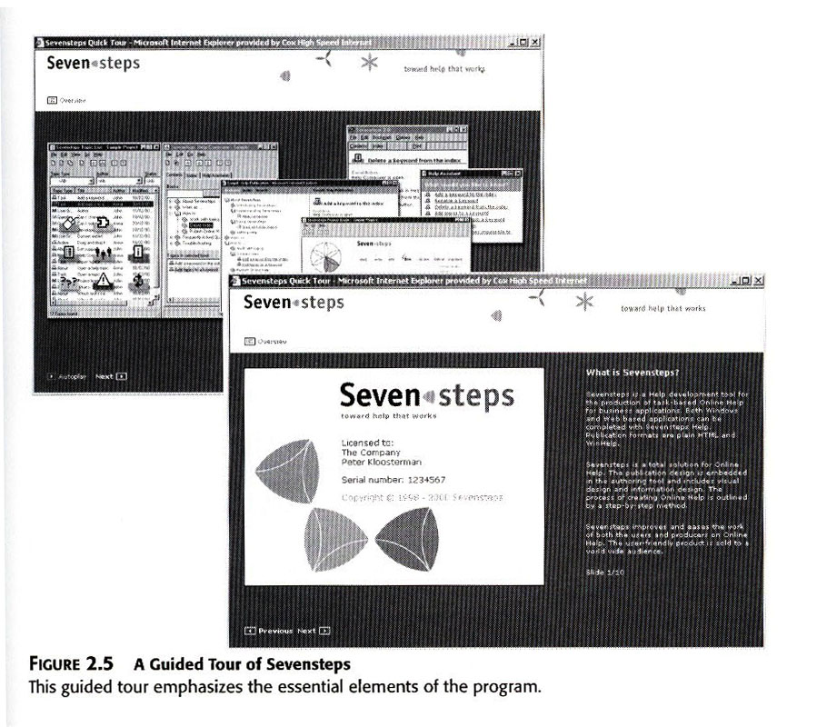
Example of Guided Tour

Slide 12
Guided Tour Definition
TOURISM short journey around a building or place with a person who tells you about what you are seeing or with a pair of headphones on which you can listen to a recorded description of what you are seeing
Thesaurus entry for this meaning of guided tour
COMPUTING an explanation of how to use a website or a piece of software that you read on a computer screen by clicking on a series of buttons or links
Thesaurus entry for this meaning of guided tour

Slide 13
B) Demonstration, design a demonstration when you want to illustrate some specific parts of a program , perhaps for a specific user, usually you use an example of the program, often a limited version of the program.
It is a more focused presentation of a particular program function being performed, which tends to be passively (negatively) viewed by users. The user will observe passively- no interaction- , like the guide tour, it informs and persuades.
The tutorial instructs the user in starting the program and tells the user what commands to use to perform the demonstrated procedure. See figure 2.6 for example.

Slide 14
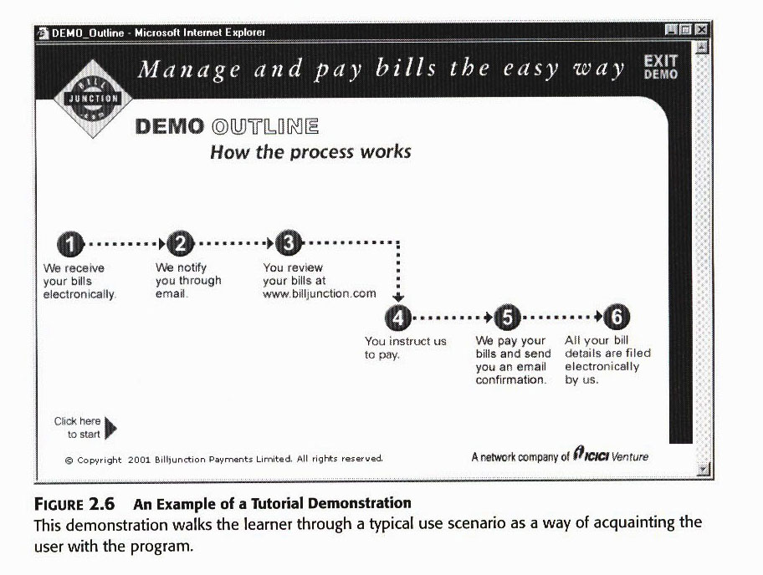
Example of Tutorial Demonstration

Slide 15
C) The Quick Start
It differs from the previous two forms, it is for experienced to advanced users with domain knowledge who want to get going with a program.
It involves significant user interaction with the program itself, and rarely uses examples.
It is a form of documentation that is generally aimed at more advanced users and provides the basic information that one needs to dive into the program and interact with it on their own. This type help users get down to work, and cover the basic and advanced procedures.
It consists of one page or folded cards that explain how to start the program and list of commands. See figure 2.7 for example

Slide 16
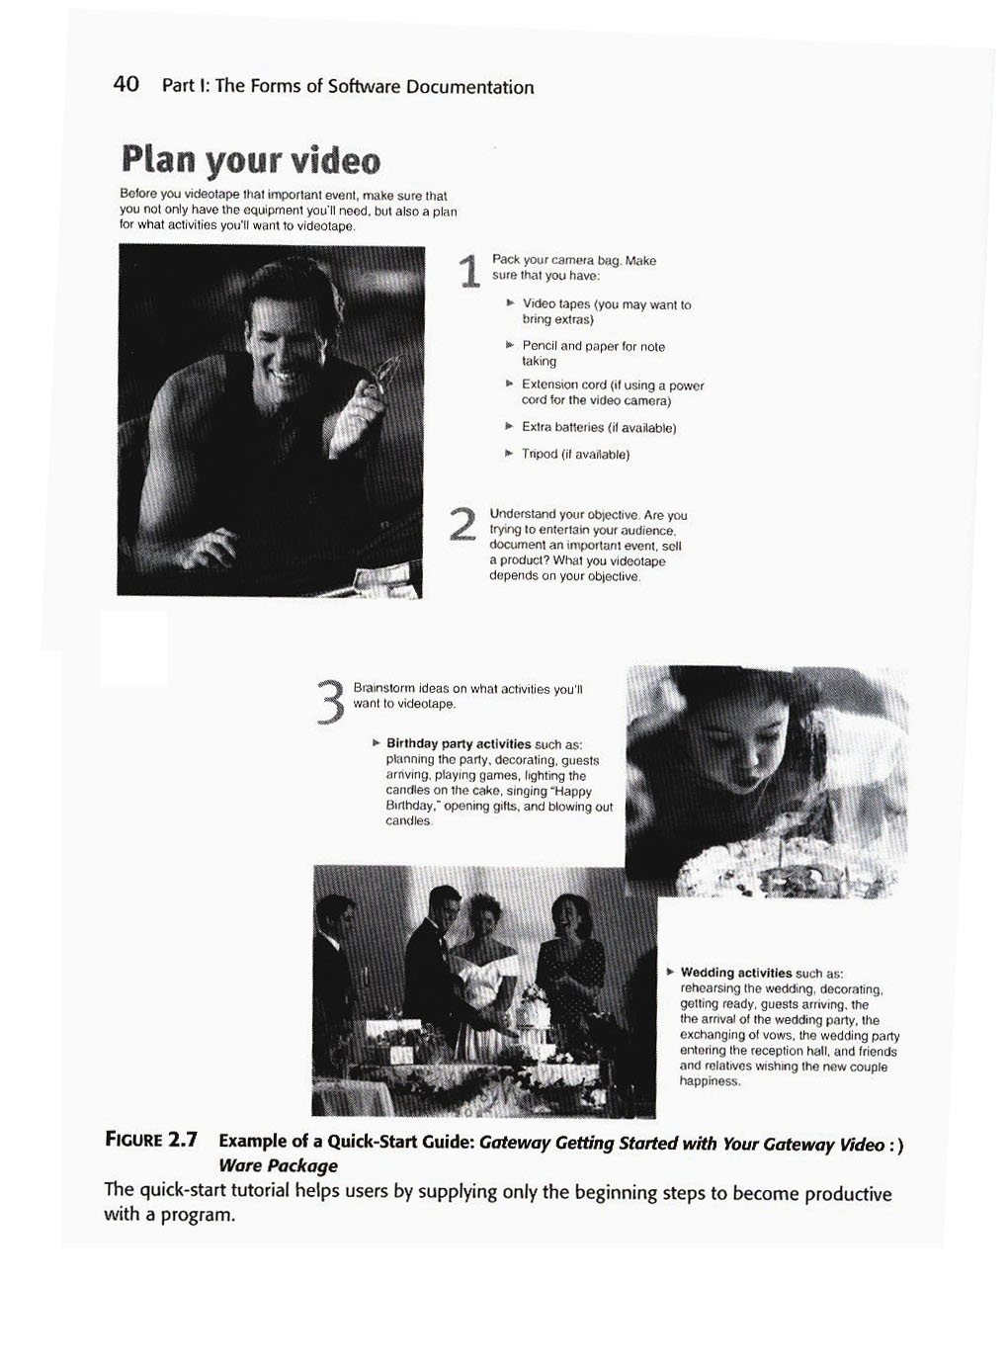
Example of Quick start guide

Slide 17
D) The Guided Exploration
This kind of tutorials contain instructions for the user to “try out” commands which encourage exploration of the program, but don’t limit the user as to exactly what to do. It contains a little discussion to give the users the experience they need.
It guides a user through a procedure, but allows for some experimentation on their own.
Usually it takes a form of short tutorial manuals, may or may not provide some scenarios (examples to follow), may include objectives and summaries to give the user direction but do not constrain him to learn specific commands. See figure 2.8 for example.

Slide 18
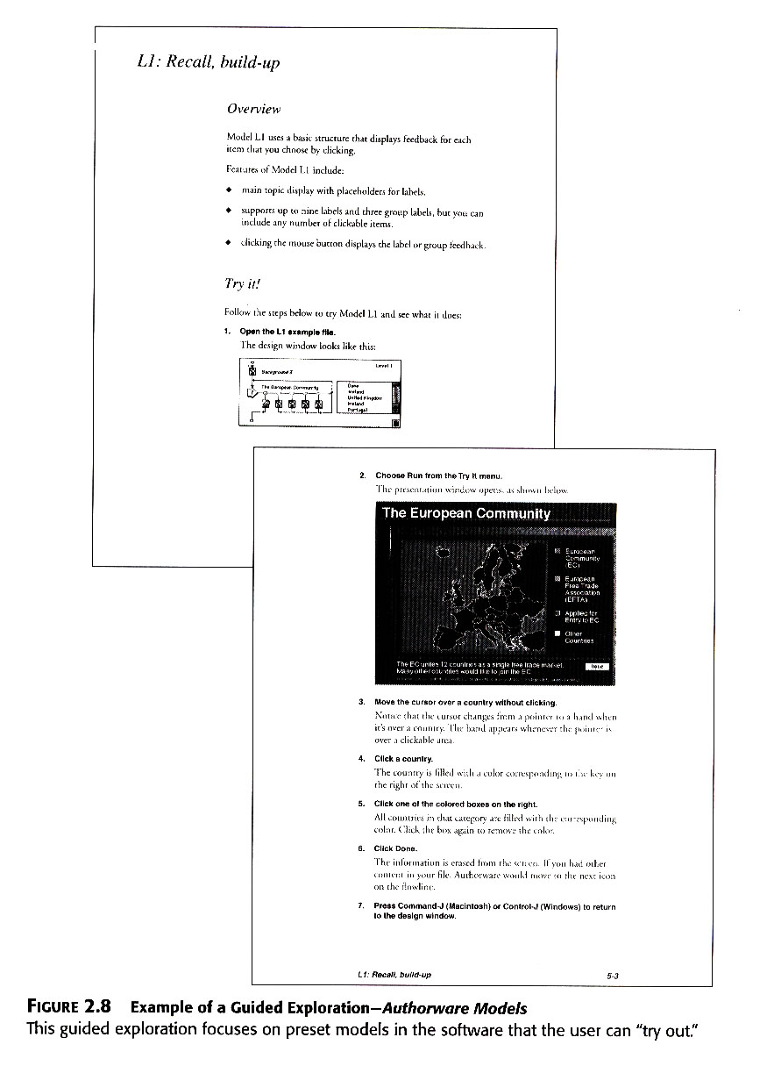
Example of Guided exploration

Slide 19
E) The Instruction Manual
- Def: A manual usually accompanying a technical device and explaining how to install or operate it.
It focuses on users who intend to operate a program or expect to have to learn a number of complicated commands and functions.
It attempts to teach as much of the software as possible through a full series of interactive lessons. It consists of lessons, each focuses on specific objective, usually tied with specific set of command.
This type of teaching relies on the principles of accumulative learning, you learn one skill before you take on another, more advanced one.

Slide 20
This kind of tutorial contains a great deal of user interaction, but not as much as the guided exploration, often contains practice sessions and/or evaluation test to see if the user learn the materials.
It takes the form of a separate tutorial manual or section of a manual, usually follows scenarios or present problems for user to solve, so you may have to develop data sets, document, templates, databases or other elements the program requires for working. See figure 2.9 for example

Slide 21
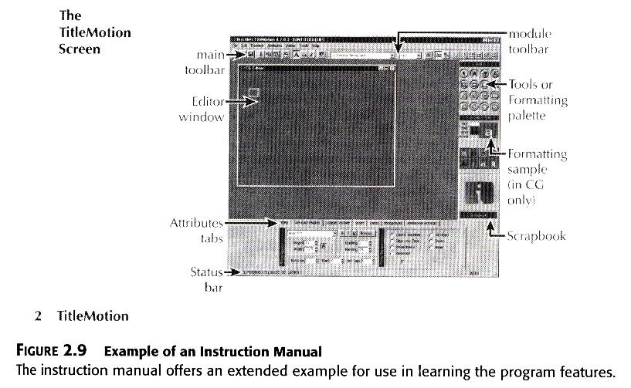
Example of an instructional manual

Slide 22
4- Present Skills in A Logical, Cumulative
Structure, in guide one and two we saw how you need to articulate the program features in the form of instructional objectives, and how to tie these to the relevant tasks in the program. However, the job of designing tutorials requires you to assemble the task in a logical order of lesson.
For example in an accounting program scenario (checking for payment of a bill), you might need these tasks: looking up a record, checking the appropriate screen for payment, closing the screen, and printing an invoice for the customer.

Slide 23
5- Offer Highly Specific Instructions, your instruction or lessons should focus on a specific scenario or problem that the user would recognize.
By soliciting very specific actions and information from their users, tutorials promote real-world skill building as well as confidence and interest in the program. Some examples of specific instructions include: Specific data, Tools, Screens, Commands.
It should include a specific details not a generic instruction such as
“enter a number” instead “enter 1234”.
Often users with new software feel insecure about new program, they may think they will break some hardware or lose some data they see time spent learning new software as time spent away from their job, or they feel stupid going to class or trying to learn a new system.

Slide 24
6- Give Practice and Feedback at Each Skill
Level.
Build a pattern of expositions: repeat the following rhythm:
- give action to take, select Open.. From the file menu.
- explain the result, the program will display an empty file.
Pace(walk with slow regular steps) the tutorial, keep lessons down to a bout 10-12 minutes each, this will help them concentrate well. They may get called away during a training session, so give them a chance to quit during a session without losing data and having to restart later.

Slide 25
7- Try Your Tutorial
Test it in a lab. You should base your testing on the tutorial objectives.
Design the test, also to focus on the design elements such the cuing system, the effectiveness of the graphics, and style of writing steps.
If you do not have a real user try to mock-up the situation with someone of similar background as the user.
Like any documentation, tutorials should undergo a thorough usability test. There are a variety of methods for doing so, but the most revealing information often comes from observation of an actual user making use of it in a realistic scenario.

Slide 26
Designing Tutorials
We should start with the knowledge of :
How tutorials work and When the user need them.
Because not all documentation sets contains tutorials, we should know when to use this form of documentation, and when to apply others.
The following will help you make the decision by examining some of the basic elements of tutorials:

Slide 27
1-Intention to Teach, with tutorials you want the user to gain a familiarity with skills and remember them to perform tasks later on from their memory.
Documentation like this operates on the teaching level of task orientation, which means you must create a close relationship between the persona of the writer and the reader.
So you limit the user awareness to one way, one option, one skill and this will take great deal of control and structuring of the user’s interaction with the material.

Slide 28
2- Selectivity in Choosing Material, you know that you can not teach all functions of the program. To do so would take many books. This need for selectivity means that you must know your user very well and which essential tasks need learning and which don’t, so you select the essential ones.
In the user analysis we narrow down the users from all users to potential users then to user types, then to usual scenarios of use of the programs, and finally to the typical-use scenario, and this scenario should represent the fundamental tasks of them all.

Slide 29
3- Stand Alone Design, The users only have the tutorial section to rely on to learn a program, no teacher or advisor to talk to, so the document has to do the work of these.
Such “self instructional” documentation, should take the place of teacher, textbook, workbook, lectures, question and answer session.
The tutorial section of the manual becomes the teaching environment.

Slide 30
Tutorial Users Need Special Care: Because most of the tutorial users are adult they require special considerations, there are oriented toward goals:
- They want to know why they have to learn something and what good it will do for them.
- They like to have control of their learning
- They do not like to make mistakes and often they do not realize the value of making mistakes in the learning process.
- They think of themselves as self-motivated and self-assured.
So, …

Slide 31
The more we know about these styles, the better we design effective documentation for them, we need to know how to build a tutorial module that avoid public display of a user’s mistakes, limit the lesson times, give positive feedback, and inspire a self direction in the steps.
We can accomplish this by studying how we learn programs, and how others do, and by applying the principles of task analysis to the documentation situation. The following Two design approaches need to be examined:

Slide 32
-The Elaborative Approach, It includes elements of a good storytelling, describe scenario carefully and slowly. This responds to the need of the new-to- computer user, it borrows element of instructional principles from the field of instructional design when teaching abstract and highly technical material.
When you use elaboration approach you should use lots of examples, table of commands in conjunction with accurately design steps.
You should always consider using this approach with novice users.

Slide 33
The design of the elaboration manual follows the traditional principles of lesson design:
1- Instruction results in articulated skills.
2- Skills transfer capability to real world performance.
3- Steps should present skills in a logical, cumulative structure.
4- Highly specific instructions work best.
5- Give practice and feedback at each skill level.
6- Master one skill before you going to the next.

Slide 34
-The Minimalist Approach, the people who support this approach have the following reasoning:
- Users jump the gun: they like to get start right away and they resist to read info for introduction or orientation.
- Users will skip info: users rarely read introduction and they flipped quickly through the first pages of manuals.
- Users like to lead: people like to create their own perspective on their training, they like to take charge of situation, they like to control and don’t like manipulative instructional strategies.

Slide 35
The following are the principles of this approach:
1- Focus on real task and activities. Software is not an end product in itself, but a tool to accomplish workplace task. People are not as interested in using their camera software as they are in taking picture.
2- Slash the verbiage, support reading to do, study and locate. Users read to locate necessary info rather than from front to back like reading a novel. So , the introduction, overviews, illustrative examples, statement of objectives, exercises, all will be slashed out like a long-haired recruit getting a haircut at the army barber shop.

Slide 36
3- Encourage Exploration, choose an action oriented approach, people like to go their own way, so encourage practice, “try it out”, they want to know what is inside the box, what happens if they press this key.
4- Support Error Recognition and Recovery, you should make it easy for user to get out of trouble, you should find out the common errors and try to include info for recovering from mistakes.Turn the user loose but give the steps to recover. “ if you make a mistake typing, use the backspace key”, also “ you can always restart the system without damaging the data”.

Slide 37
Comparing the Two Approaches:
1- The first used in programs with: highly abstract concepts, complicated procedures, large systems.
The second used in programs: getting started booklet, guided tours, demos, programs requiring creativity by the users.
2- Advantages of the first are: good for users who like structure, good for first time users, traditional.
Advantages of the second are: cuts writing time, less document length, interesting.
3- Disadvantages of the first are: limits document writers to one or two scenarios, boring.
Disadvantages of the second are: may frustrate the first time user, may backfire, increase testing time.

